Slide 1


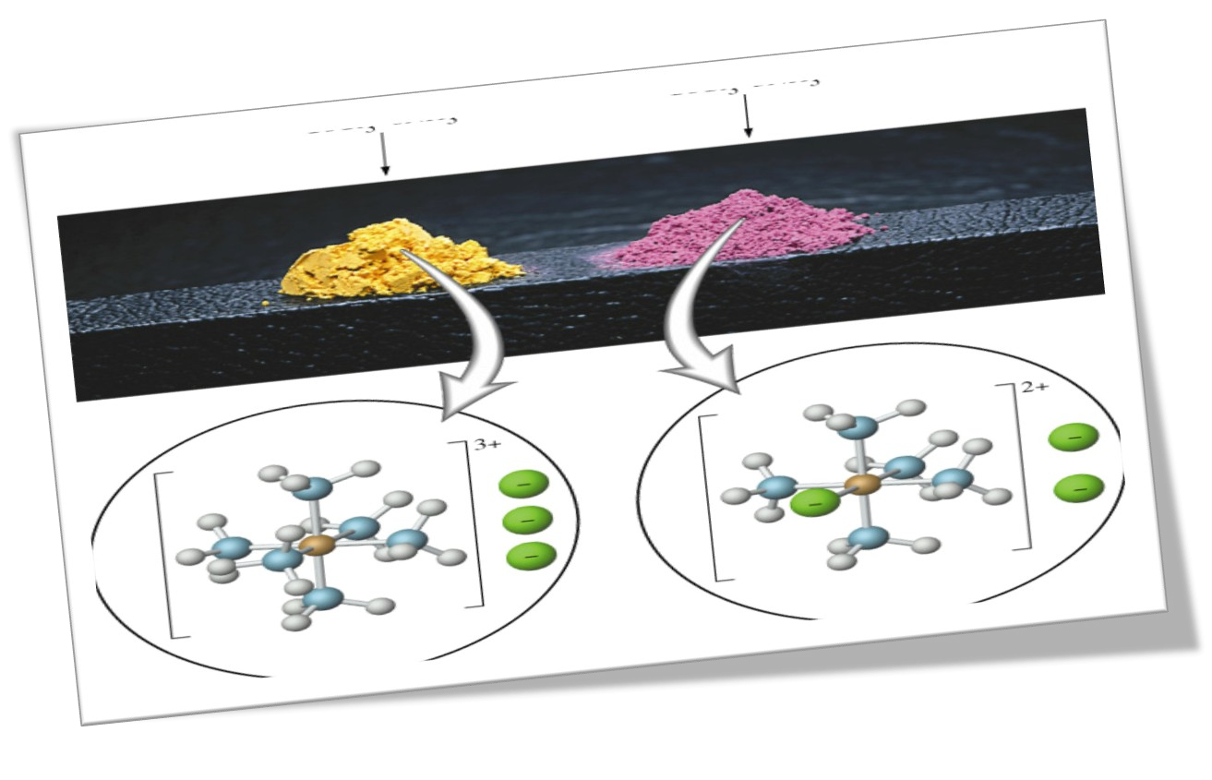


COORDINATION COMPOUNDS
Chemistry of Coordination
Compounds

Slide 2
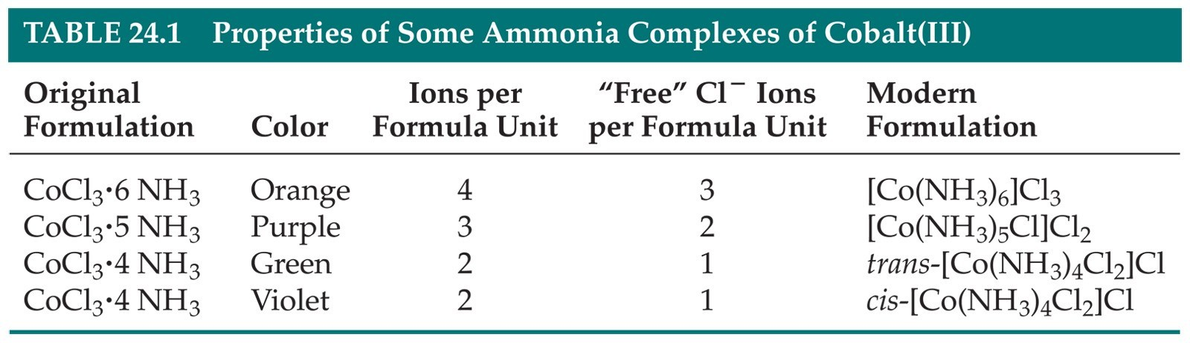
Coordination Compounds
Many coordination compounds are brightly colored.
Different coordination compounds from the same metal and ligands can give quite different
numbers of ions when they dissolve.
Chemistry of
Coordination
Compounds

Slide 3
Werner’s Theory
Werner proposed putting all molecules and ions within the sphere in brackets and those “free” anions (that dissociate from the complex ion when dissolved in water) outside the brackets.

Slide 4
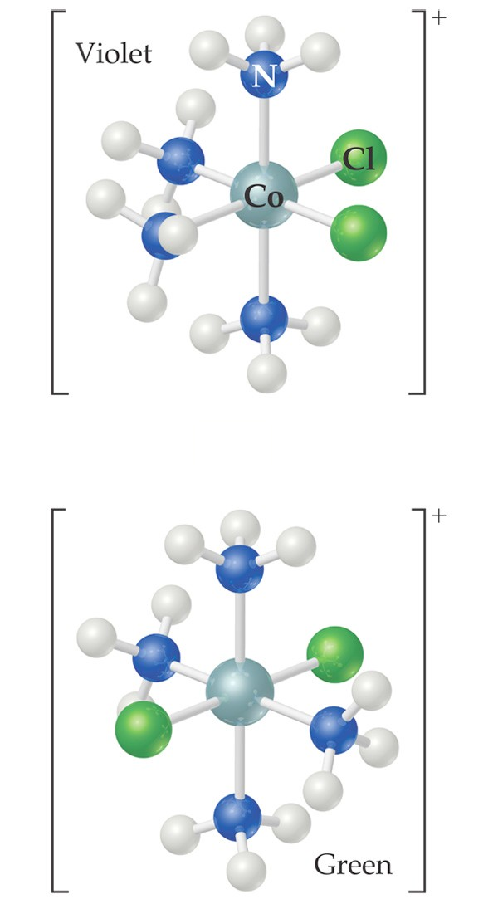
Werner’s Theory
This approach correctly predicts there would be two forms of CoCl₃ ∙ 4 NH₃.
  The formula would be written [Co(NH₃)₄Cl₂]Cl.
  One of the two forms has the two chlorines next to each other.
  The other has the chlorines opposite each other.

Slide 5
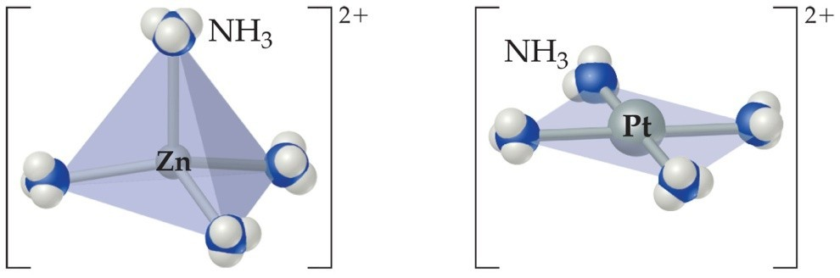
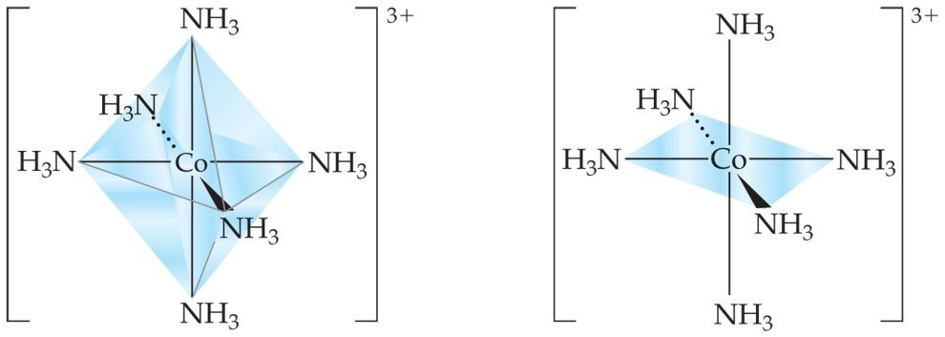
Coordination Number
The most commonly encountered numbers are 4 and 6.
Some metals, such as chromium(III) and cobalt(III), consistently have the same coordination number (6 in the case of these two metals).

Slide 6
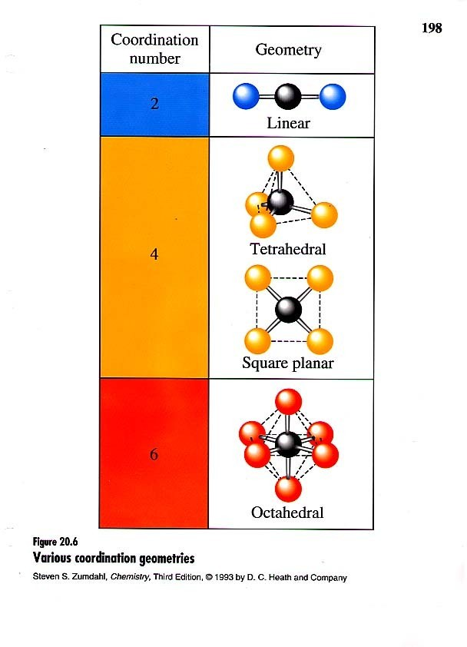
Geometries
Shape of various coordination compounds depends upon the number of ligands around central atom.

Slide 7
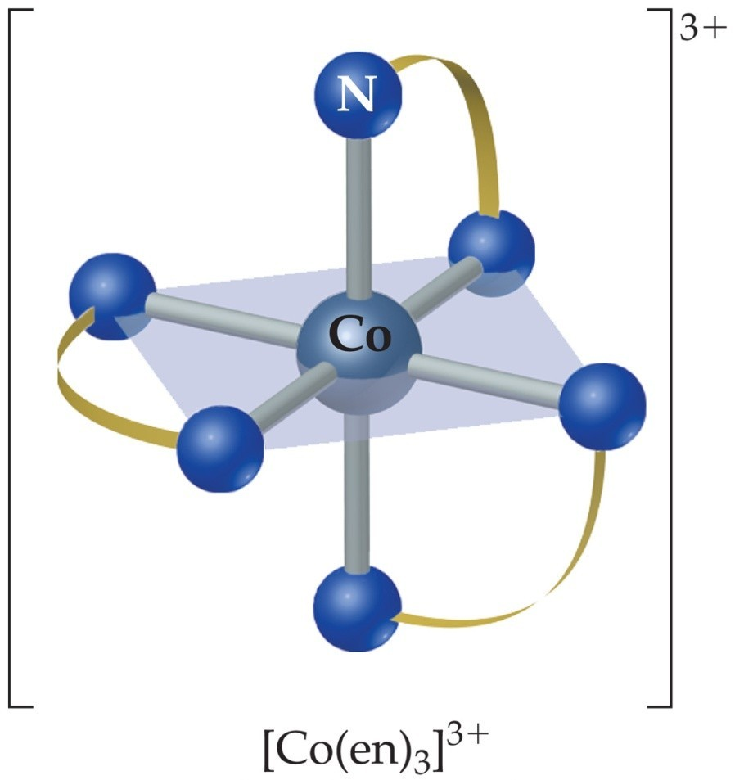
Denticity of Ligands
Some ligands have two or more donor atoms.
These are called polydentate ligands or chelating agents.
In ethylene diamine , (NH₂CH₂CH₂NH₂ ) represented here as en, each N is a donor atom.
Therefore, en is called bidentate.
Chemistry of Coordination
Compounds

Slide 8
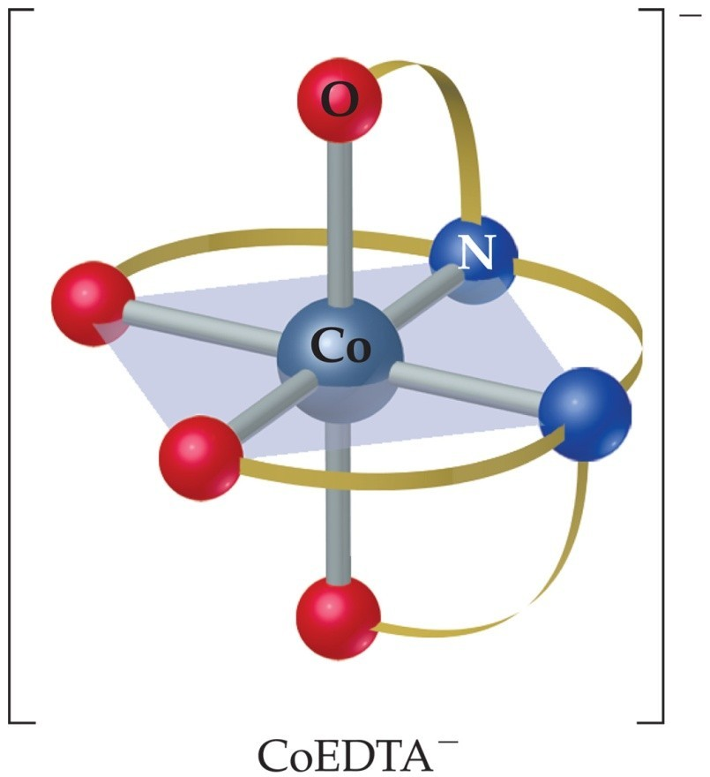
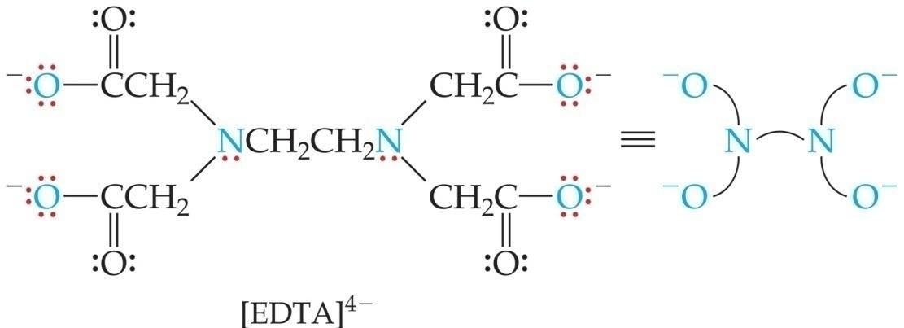
Polydentate Ligands
Ethylene diamine tetra acetate, shortly abbreviated as EDTA, has six donor atoms.
Chemistry of
Coordination Compounds

Slide 9
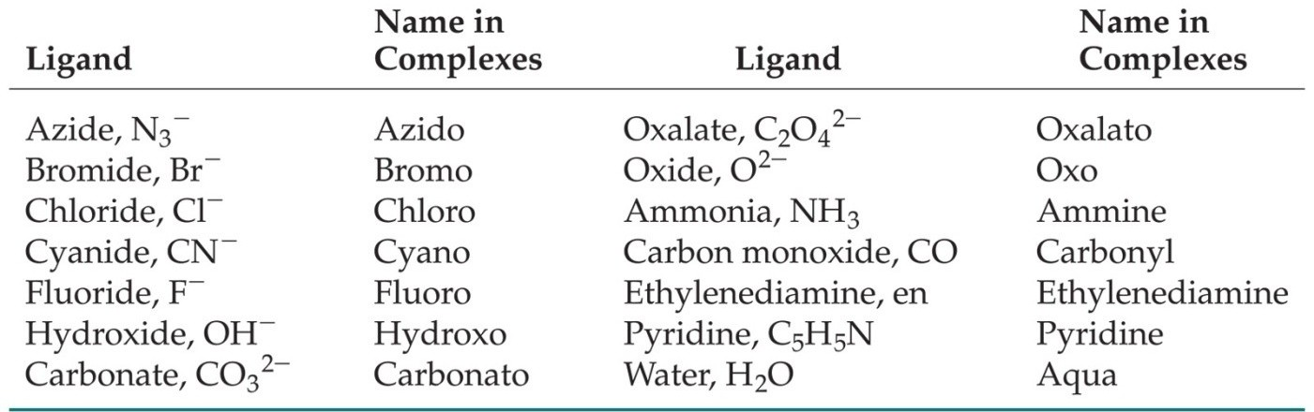
Nomenclature of Coordination Compounds
The basic protocol in coordination nomenclature is to name the ligands attached to the metal as prefixes before the metal name.
Some common ligands and their names are listed above.
Chemistry of Coordination
Compounds

Slide 10
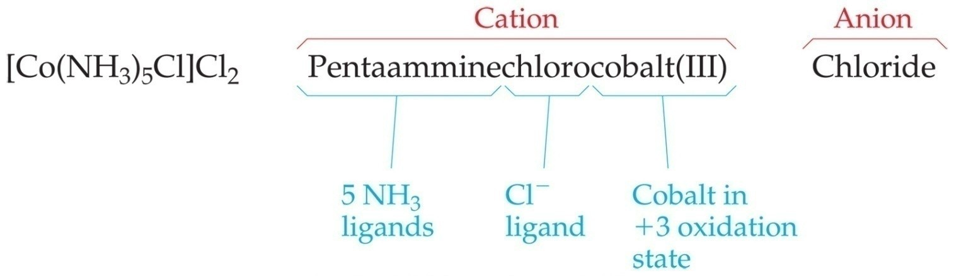
Nomenclature of Coordination Compounds
As is the case with ionic compounds, the name of the cation appears first; the anion is named last.
Ligands are listed alphabetically before the metal. Prefixes denoting the number of a particular ligand are ignored when alphabetizing.

Slide 11
Nomenclature of Coordination Compounds
The names of anionic ligands end in “o”; the endings of the names of neutral ligands are not changed.
Prefixes tell the number of a type of ligand in the complex. If the name of the ligand itself has such a prefix, alternatives like bis-, tris-, etc., are used.for eg.
[Co(NH₂CH₂CH₂NH₂)₃]₂(SO₄)₃ is named as :
Tris(ethane-1,2-diammine)cobalt(III)sulphate

Slide 12
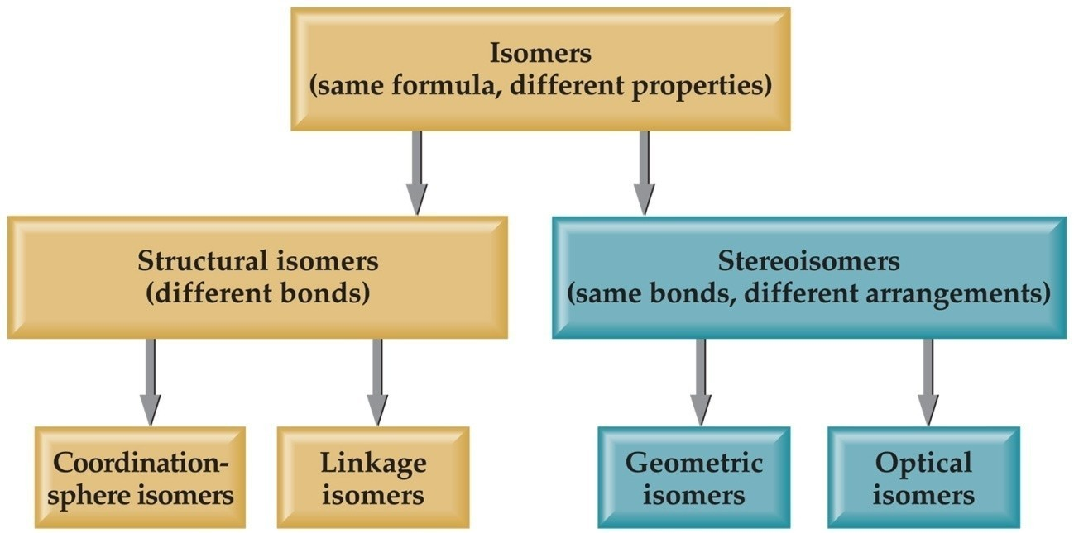
Isomers
Isomers have the same molecular formula, but their atoms are arranged either in a different order (structural isomers) or spatial arrangement
(stereoisomers).

Slide 13
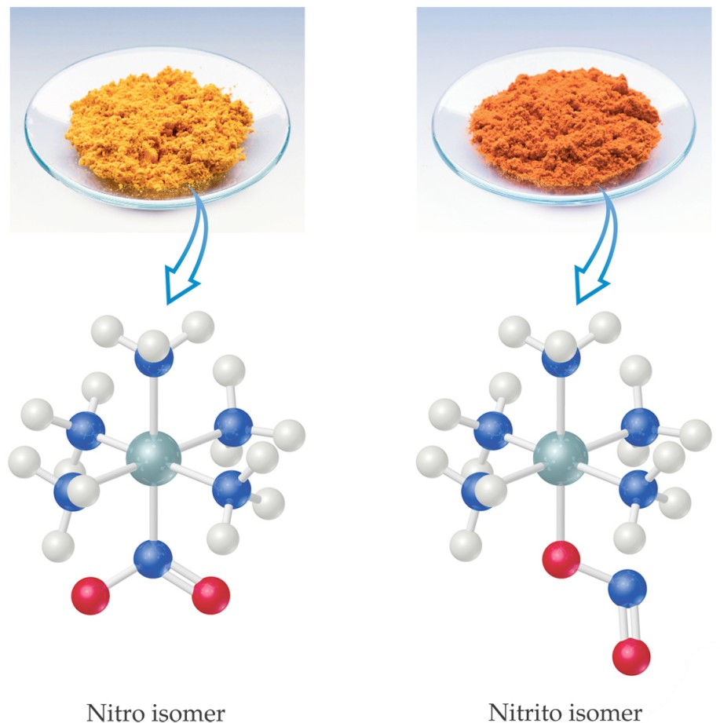

Structural Isomers
If a ligand (like the NO₂ group at the bottom of the complex) can bind
to the metal with one or another atom as the donor atom, linkage isomers are formed.

Slide 14
Structural Isomers
Some isomers differ in what ligands are bonded to the metal and what is outside the coordination sphere; these are coordination-sphere isomers.
Three isomers of CrCl₃(H₂O)₆ are
➢The violet [Cr(H₂O)₆]Cl₃,
➢The green [Cr(H₂O)₅Cl]Cl₂ ∙ H₂O, and
➢The (also) green [Cr(H₂O)₄Cl₂]Cl ∙ 2 H₂O.

Slide 15
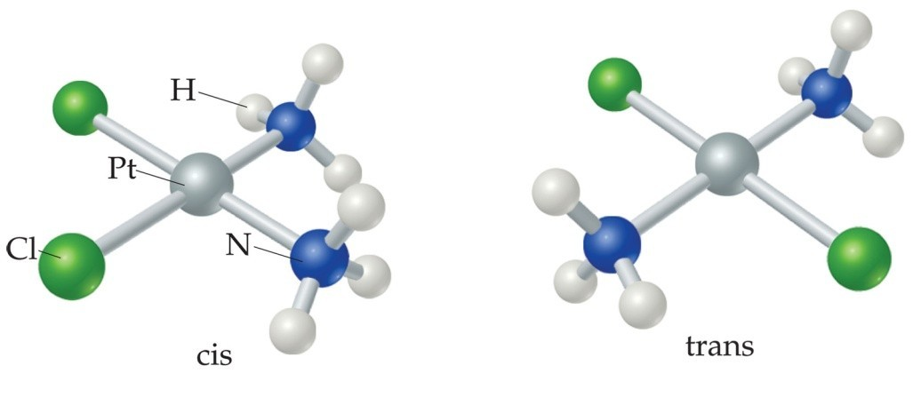
Stereoisomers
GEOMETRIC ISOMERS
With these geometric isomers, two chlorines and two NH₃ groups are bonded to the
platinum metal, but are clearly different.
➢cis-Isomers have like groups on the same side.
➢trans-Isomers have like groups on opposite sides.

Slide 16
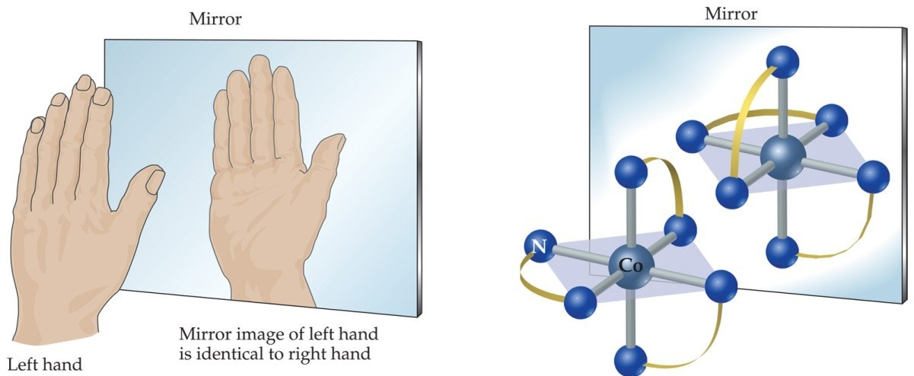
Stereoisomers
Other stereoisomers, called optical isomers or enantiomers, are mirror images of each other.
Just as a right hand will not fit into a left glove, two enantiomers cannot be superimposed on
each other.
Chemistry of
Coordination
Compounds

Slide 17



Valence bond theory
 | Coordination number | Type of hybridisation | Structure | According to this theory, the
 | 4 | sp³ | tetrahedral
metal atom or ion under the influence of ligands can use its (n-1)d, ns, np or ns, np, nd orbitals for hybridisation to yield a set of equivalent orbitals of definite geometry such as octahedral, tetrahedral, and square planar. These hybridised orbitals are allowed to overlap with ligand orbitals that can donate electron pairs for bonding
4
dsp²
Square planar
5
sp³d
Trigonal bipyramidal
6
sp³ d² (nd orbitals are involved – outer orbitals complex )
Octahedral
6
d²sp³((n-1) d orbitals are involved –inner orbital )
octahedral
Chemistry of Coordination Compounds

Slide 18
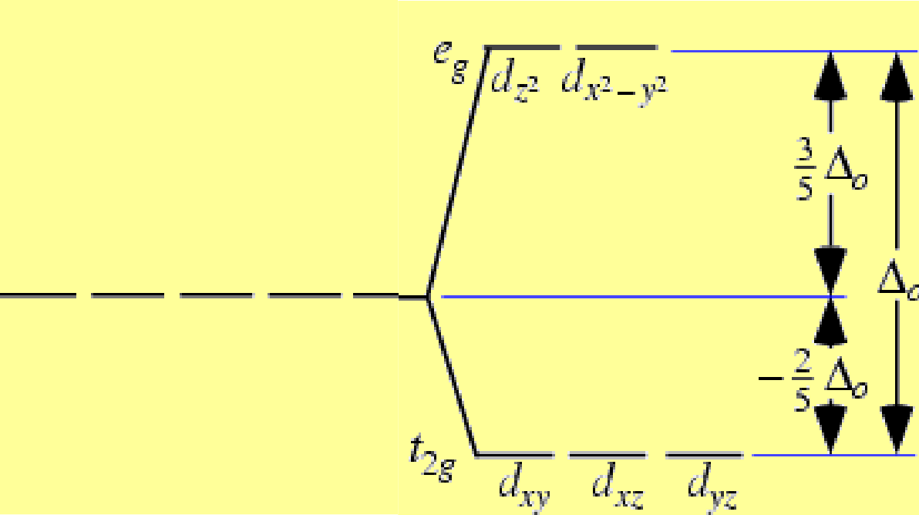
Crystal Field Theory
•
Created to explain why transition metal ions in complexes (having unfilled d-shells) are not necessarily paramagnetic.
•
With coordination bonding, valence d-orbitals are not truly degenerate. Instead, they “split”.
➢ Some are lower in energy (more stable) and some higher.

Slide 19
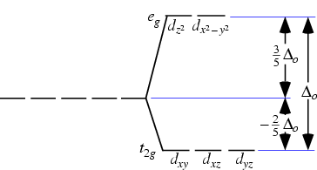
Crystal field theory
The gap between the higher and lower energy levels is called the crystal-field splitting energy, which varies with each ligand, yielding different E, (different λ, different colors).
e- in an “unfilled” d-shell can actually be all paired (i.e., diamagnetic).
Ex: Co³⁺ (has 6 d e-)
•

Slide 20
Applications of coordination compounds
Coordination compounds are used for many applications :
•
•
•
•
•
Extraction processes of gold and silver.
Used as catalysts in many industrial processes. Hardness of water (EDTA).
Purifications of metals.
Chelate therapy (removal of toxic proportion of metals in the body).
EDTA is used in treatment of lead poisoning.
•
•
Platinum compounds inhibits the growth of tumors.

Slide 21


